Slide 1

CS+Social Good
Human Centered Design Overview
Notes:
Empathy: Empathize with family in airport

Slide 2

Design Thinking
Notes:
If you’ve done the design thinking crash course, you should skip this slide.

Slide 3

Empathize
Empathy is the foundation of a human-centered design process; by deeply understanding people, we are better able to design for them.
Immerse: Experience what your user experiences.
Observe: View users and their behaviors in the context of their lives.
Engage: Interact with and interview users through both scheduled and short encounters.
Discover: Uncover people’s expressed and latent needs to best design solutions for them.
Understand: Through observation and interviews, we can build a picture of our users’ motivations based on what they say, do, think, and feel.

Slide 4
Your Task
Empathize with people in your problem space.
You have at least until next Wednesday to do this
Ideal options:
Interview one or more people (if possible)
Observe people
If this isn’t possible, here are some alternatives:
Read people’s stories/perspectives of the situation
Immerse yourself in their situation by looking for resources/communities they have (i.e. facebook groups, etc.)
Goal: **Understand something about people that you did not already know**
Most valuable part of the project if you put time into this
Notes:
Important to stress the

Slide 5
Option 1: Interview
Observable needs: What are some problems your user is facing?
Latent needs: What do your observations say about this person outside of this context? How do they feel? What motivates them?

Slide 6
Option 2: Observation
What? What is the person doing (what are the concrete, observable facts)?
How? How is the person doing that? (what emotions and techniques are present?)
Why? Why is the person doing that? In what way? (what inferences can we draw?)

Slide 7

Your turn: Observations
Take the next 3 minutes to write down as many observations about this man as you can, trying to understand as much as you can about his situation.
What? What is the person doing? (what are the concrete, observable facts)?
How? How is the person doing that? (what emotions and techniques are present?)
Why? Why is the person doing that? In what ways can we draw inferences about the scene?

Slide 8

Share!
What were your findings?

Slide 9
Your turn: Interview (pairs)
Can you tell me about something you do outside of school? (4 min)
What are some of this student’s needs/wants/values inside the context of this activity? Outside?
How do you feel about . . . ?
Can you tell me about how you started . . . ?
What is your best/worst/craziest/most memorable experience with . . .?
What’s something I would find surprising about . . . ?
How do you feel about . . .?
What’s a typical day like doing . . . ? An atypical day?
Why is . . . important to you? Why do you feel that way?

Slide 10
Share!
What were your findings?

Slide 11
Why does it matter?
Problem solving and innovation that works
Idea and innovation optimization
Innovative product and process design
Human/customer-centered problem solving and innovation to create tailored, more impactful products and services

Slide 12

Design Thinking in Action

Slide 13
What next?
Immerse yourselves in your community: make these observations about the people around you, thinking of how you can best apply your skills to design socially-impactful projects. Work with friends/your project partners for this portion.
You can use the empathy Field Guide
Observations
Direct Interviews

Slide 14
Where to start?
Think of a place, area of interest, or person you want to design for and get out there!
Direct Interviews:
Visit a site, plan to interview someone there in advance
Visit a site, interview random passersby
Direct service (volunteer-work)
Speak directly with acquaintances: find out what matters to them, and why
Online:
Research organizations thoroughly
Explore people’s stories
Observe Facebook groups, community pages, forums, other social media
Interactions with photographs, news articles, resources, YouTube videos

Slide 15

Your task: Reach out!

Slide 16
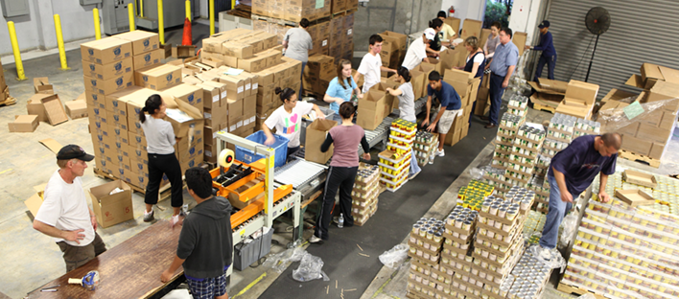
Your task: Reach out!

Slide 17

Your task: Reach out!

Slide 18
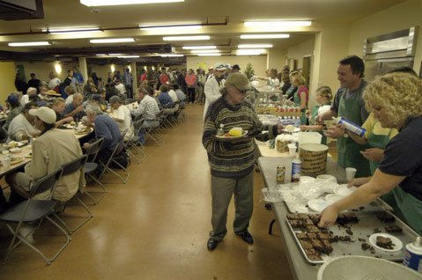

Your task: Reach out!

Slide 19

Your task: Reach out!

Slide 20
To-do:
Get out into your community (strongly recommended to get the most out of the need-finding process)
Really get to know the person/people you’re engaging with
Try to understand what drives them and why
Observe and report!
Approach the need-finding process with an open mind
If meeting someone is not possible:
Use one of the options from before
Try and answer the same questions about people
Understand their perspective, learn something new about them that you did not know before
Note: It is important to be respectful of others in the interviewing process. Please be conscientious when approaching people and respectful of their time.

